Slide 1
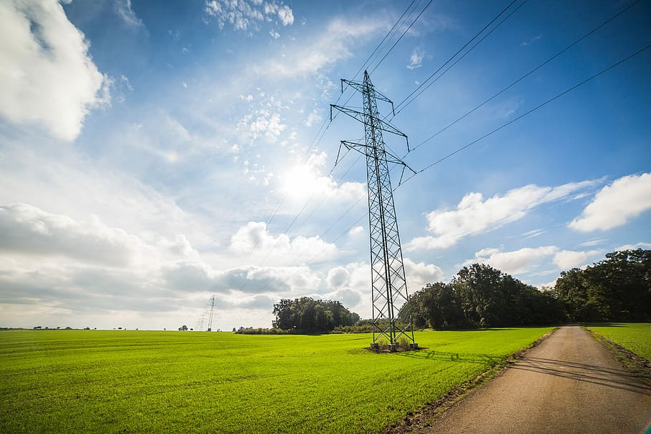



City Power Consumption
Analysis & Prediction
This project analyzes city power consumption data to predict usage in Zone A. We explored the dataset, preprocessed it, and evaluated multiple machine learning models to find the best predictor.

Slide 2


Data Overview
1
Dataset Size
52,583 rows and 9 columns of power consumption data.
2
Key Features
Temperature, humidity, wind speed, diffuse flows, and air quality index.
3
Target Variable
Power consumption in Zone A.

Slide 3
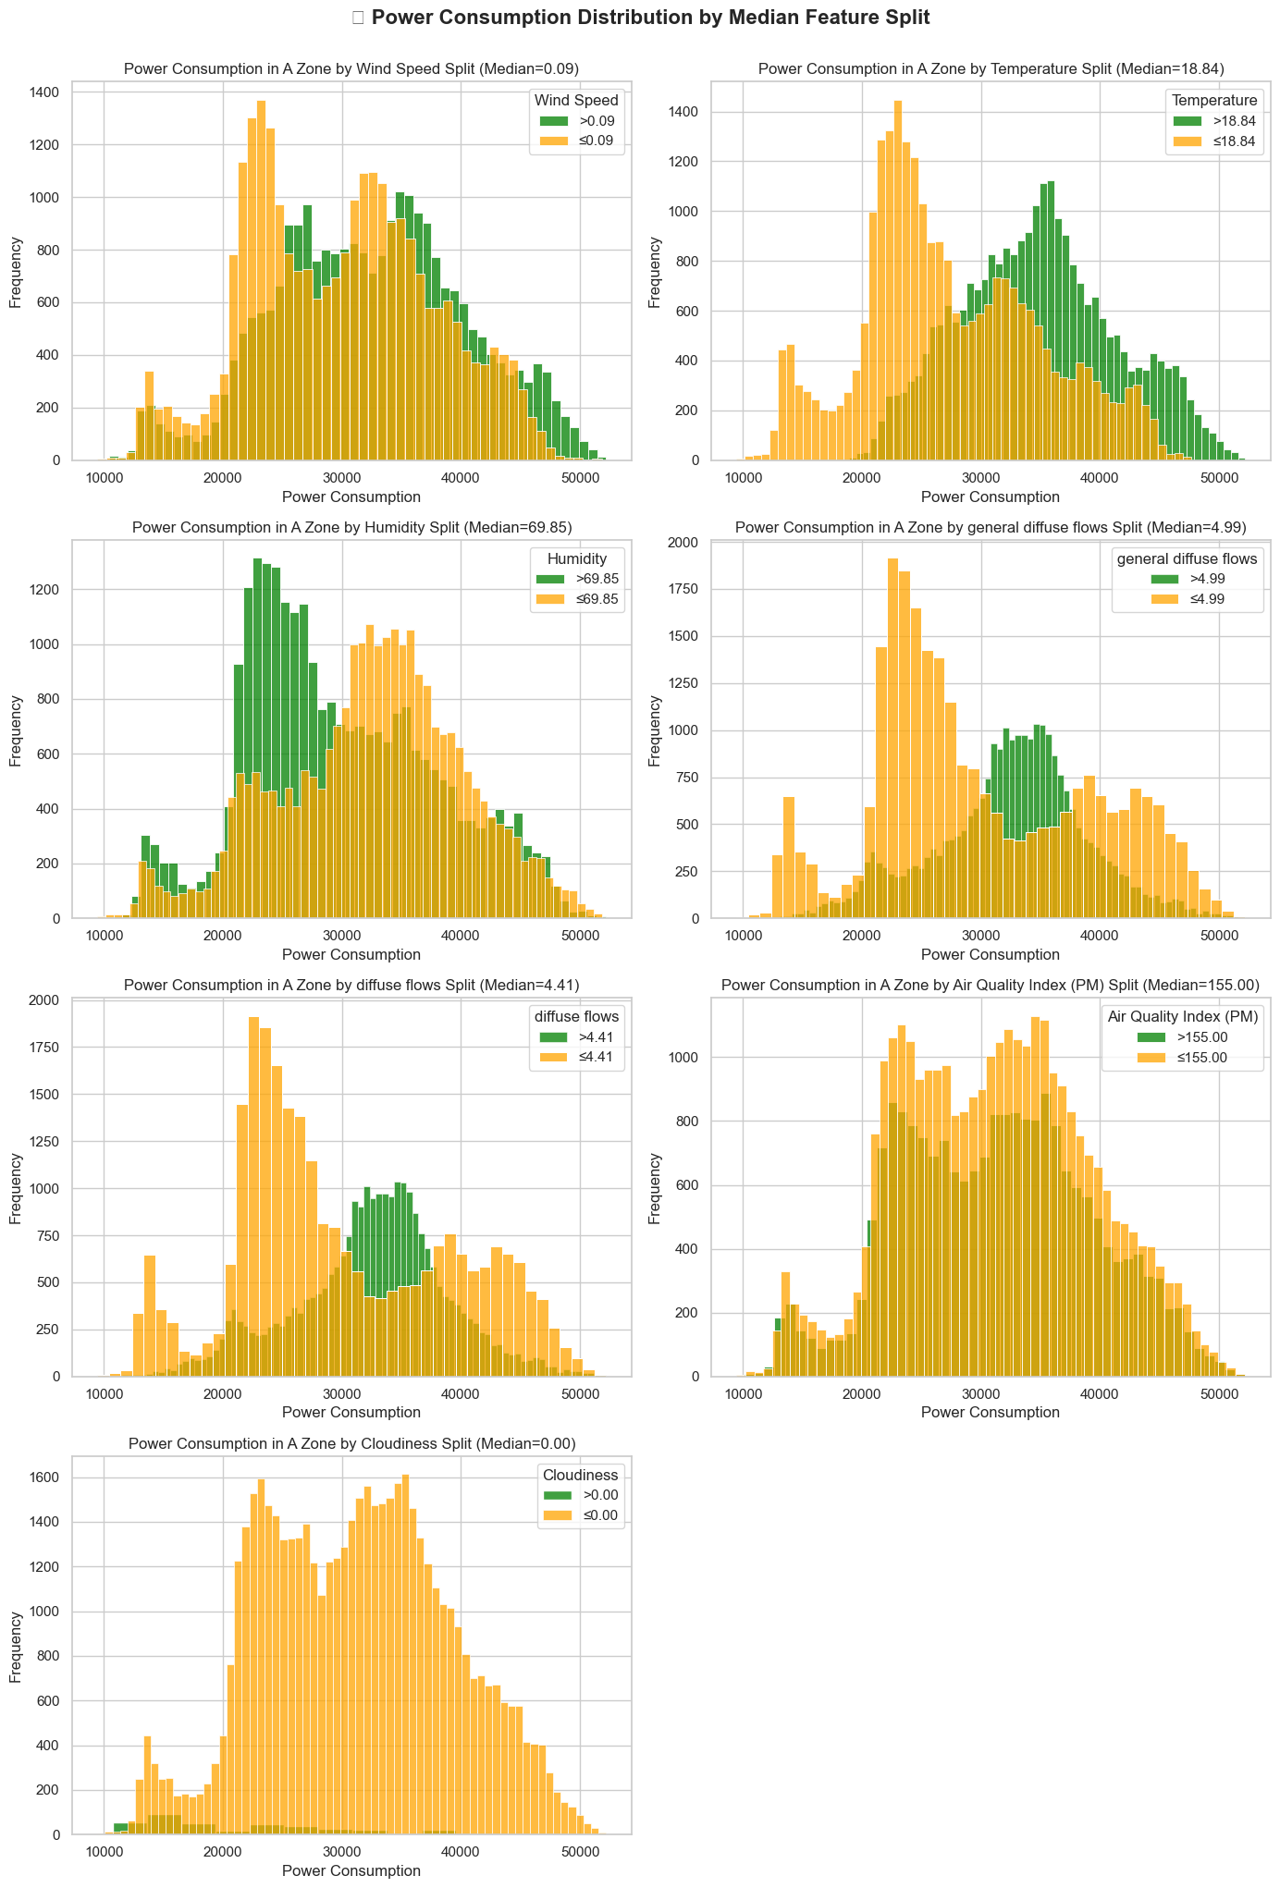
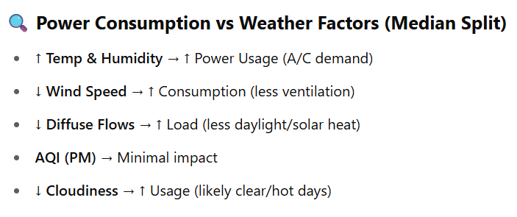
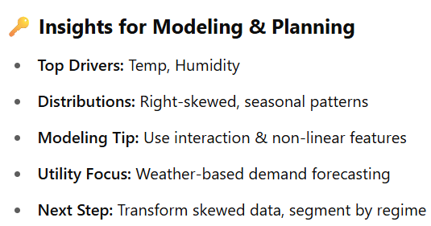
[ EDA ] Exploratory Data Analysis
Seasonal pattern
Seasonal pattern

Slide 4
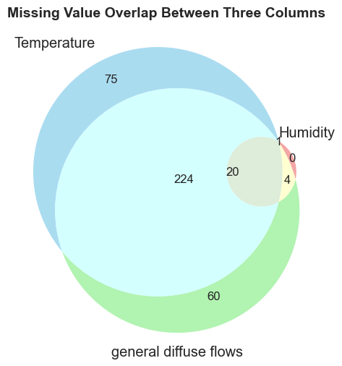
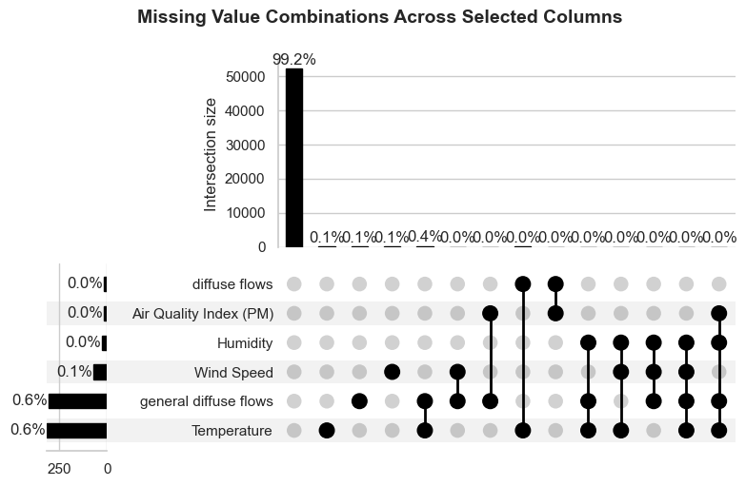
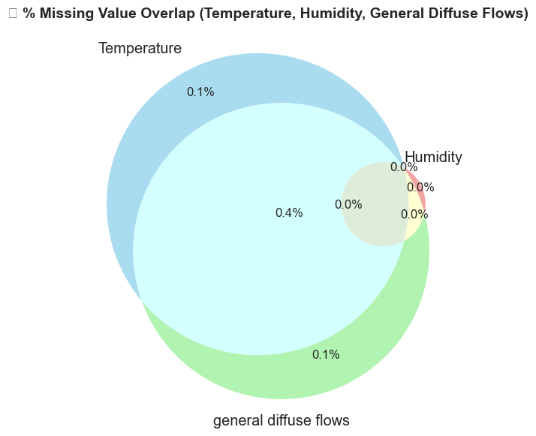
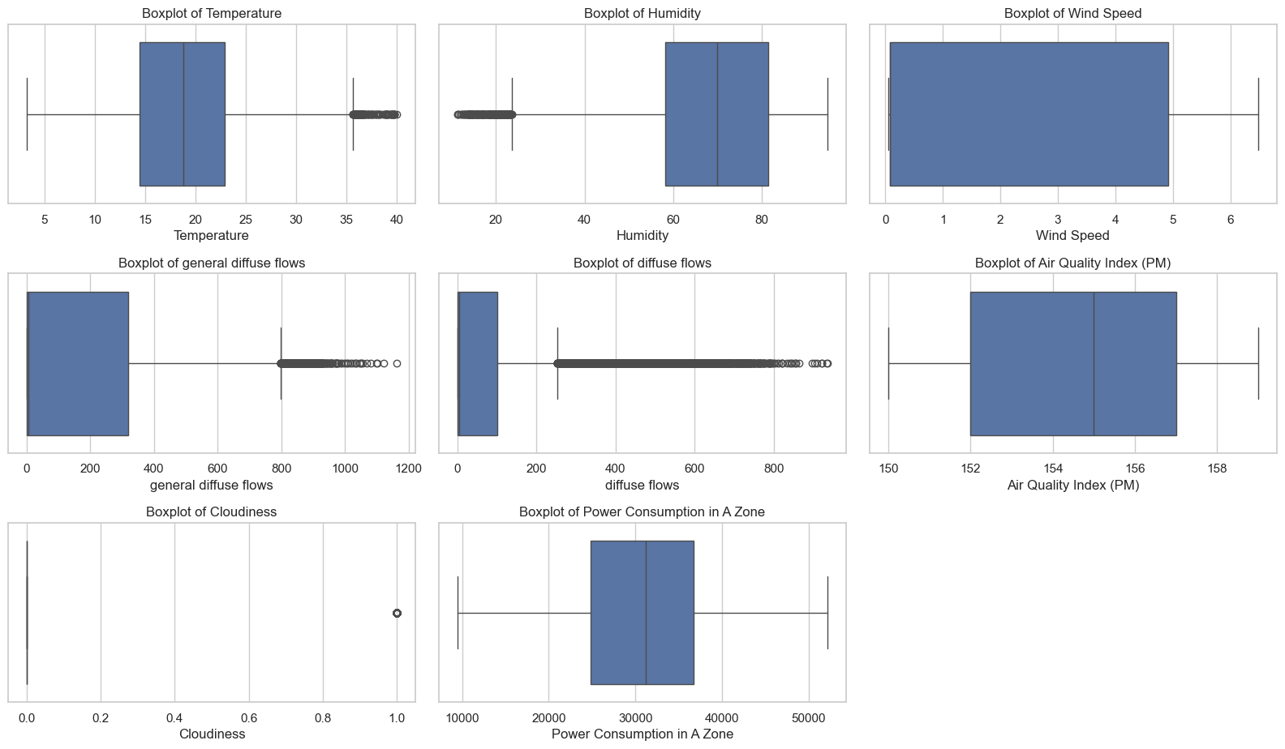
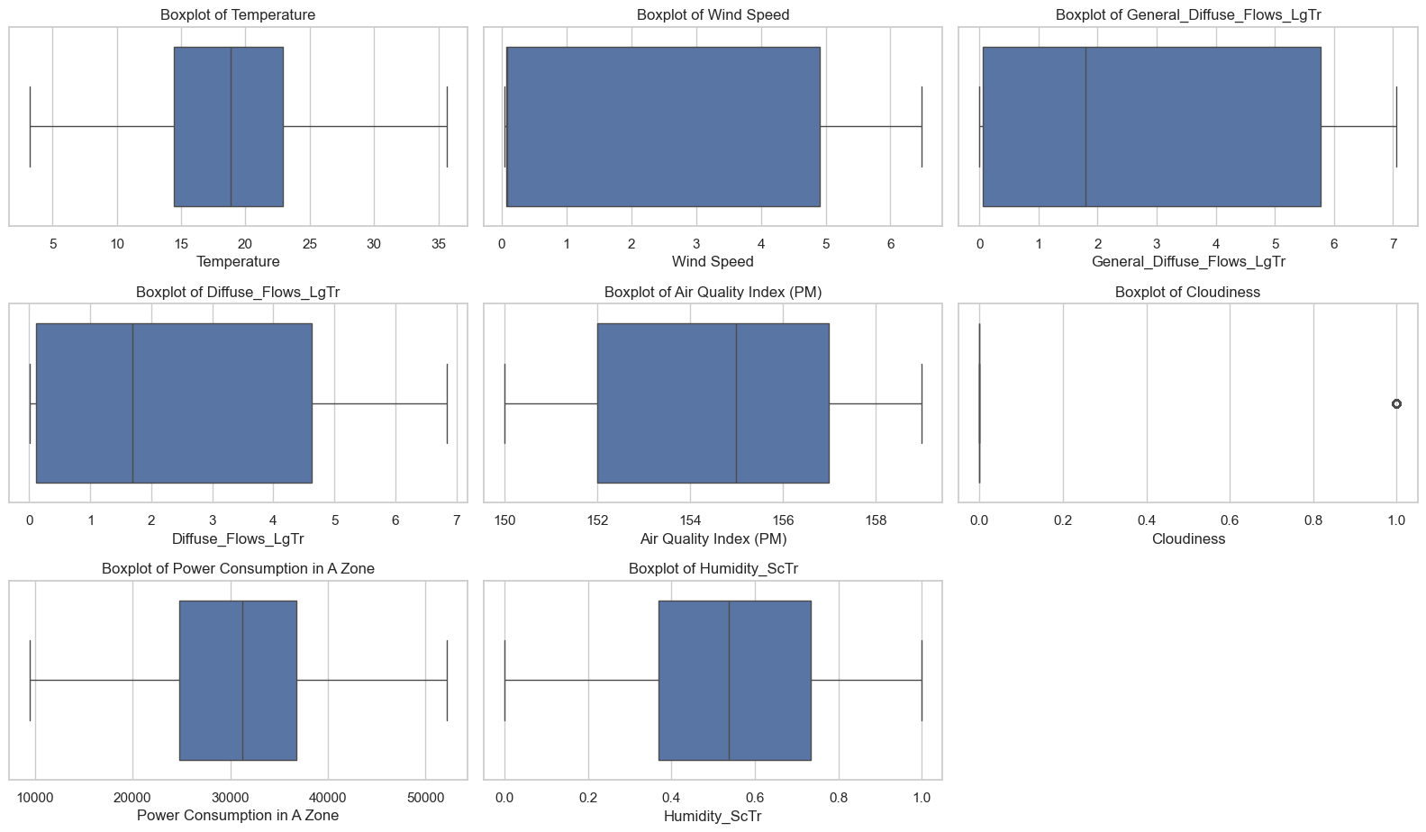
[ EDA ] Data Processing
1
Handling Missing Values
Used median imputation for numerical variables and most frequent for categorical.
2
Outlier Treatment
Applied outlier clipping to reduce impact of extreme values.
Before
Clipping
After
Clipping

Slide 5
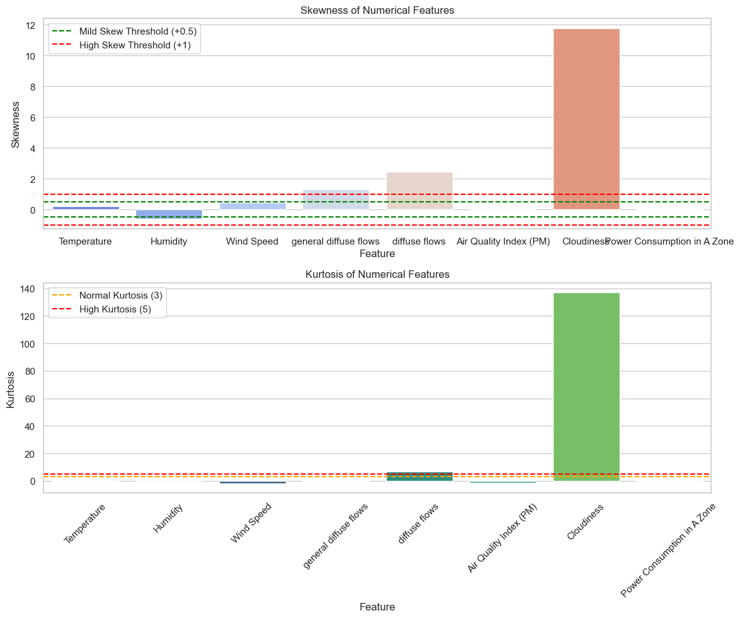
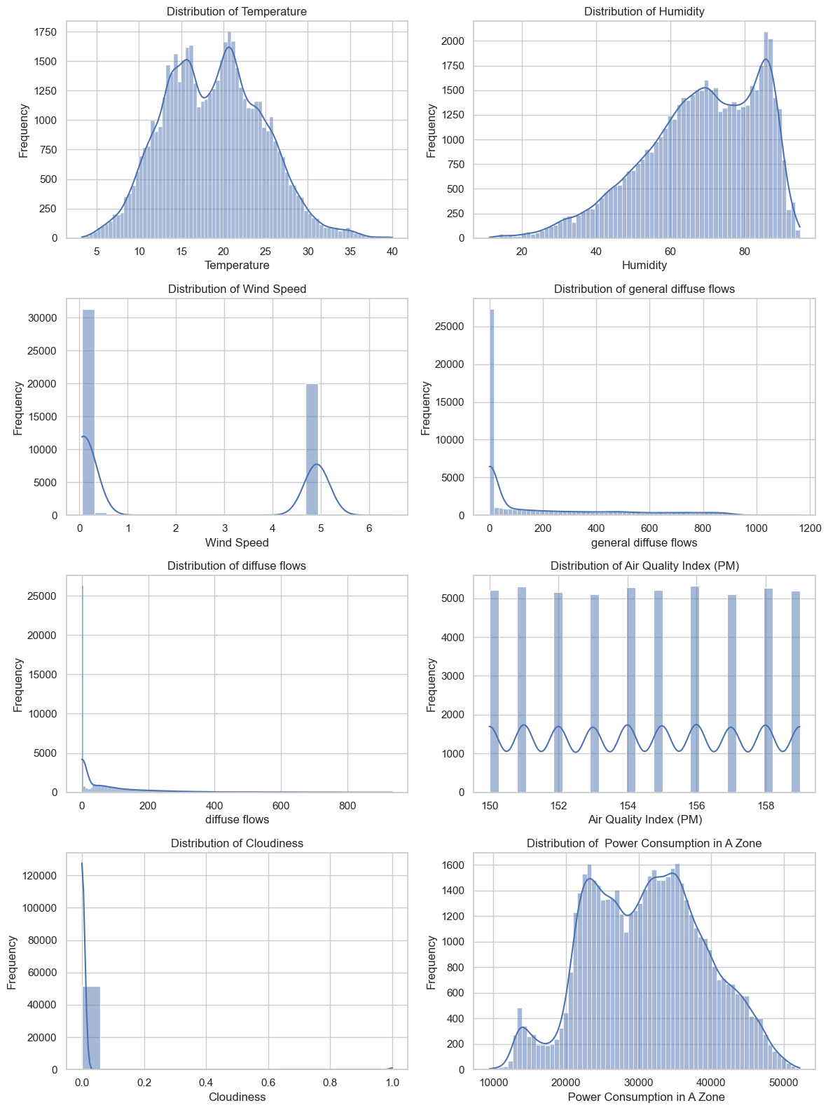
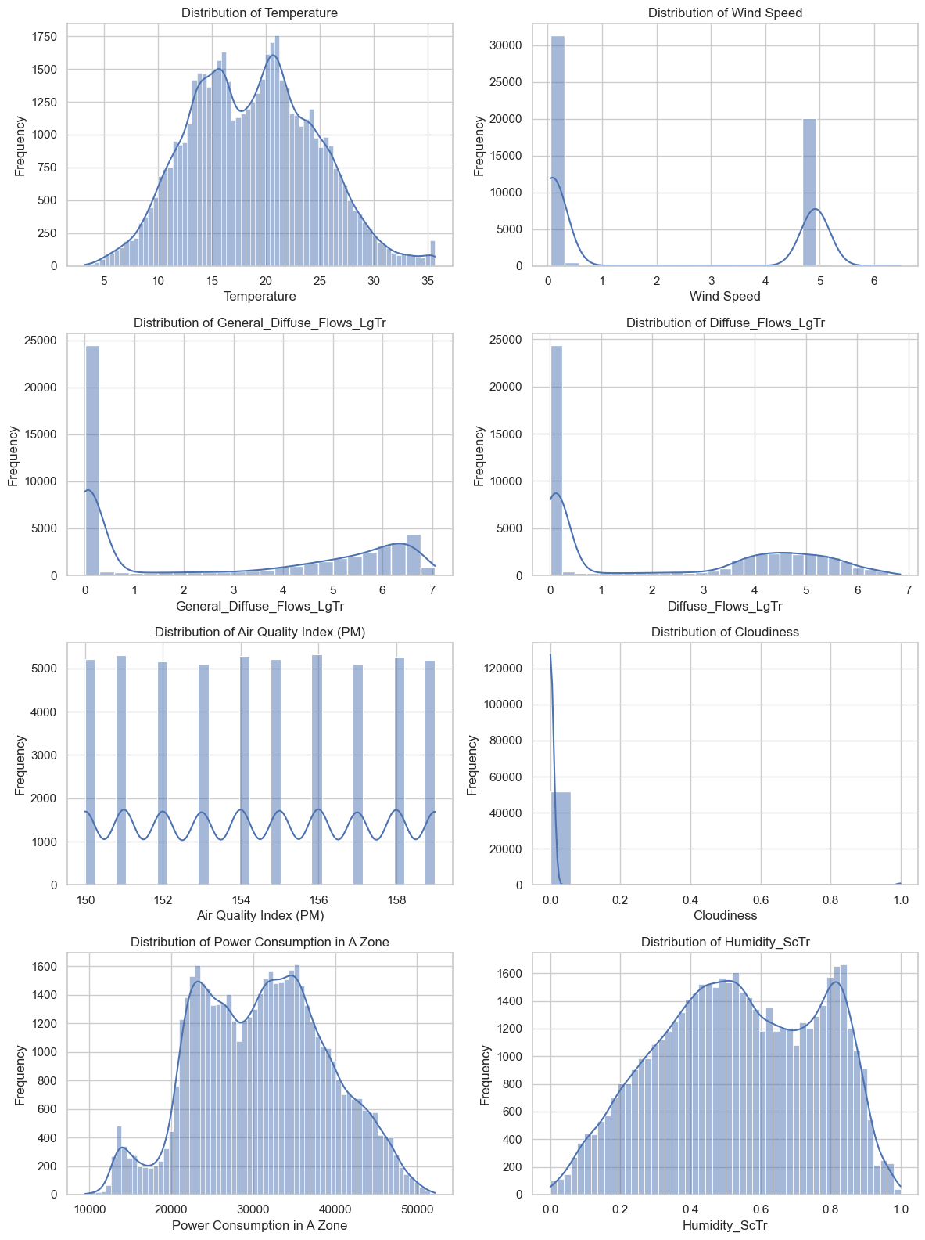
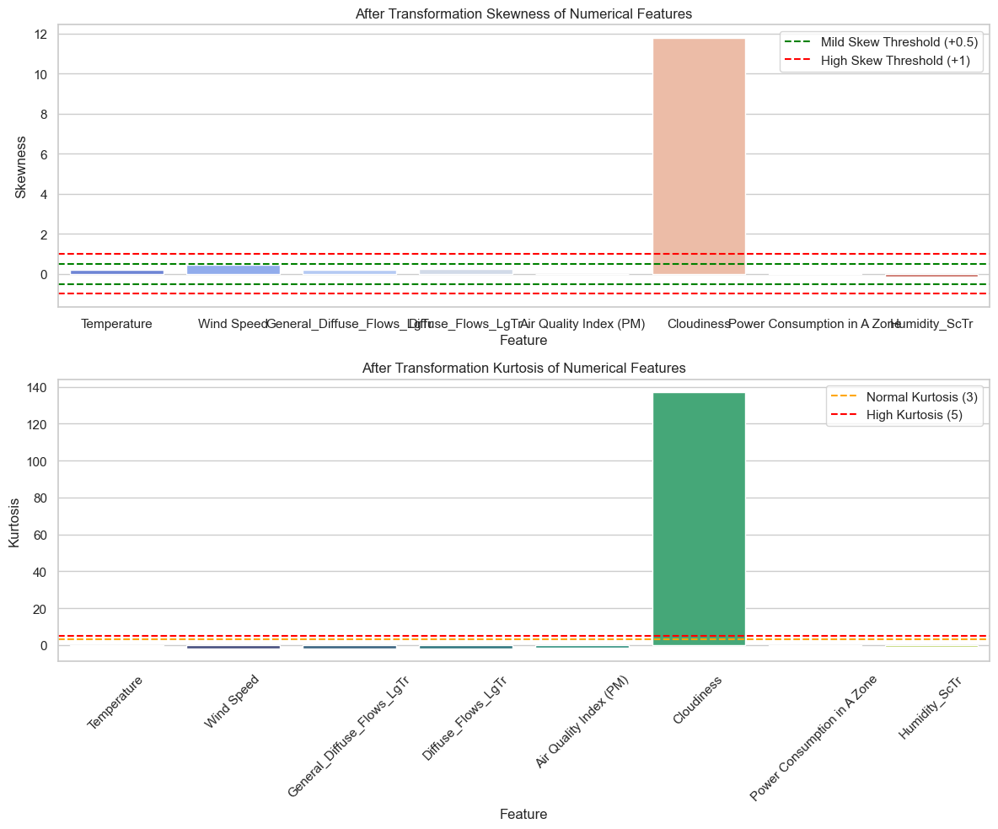
3
4
[ EDA ] Data Processing
Features Scaling
Hypothesis testing
1. Square transformation to Left Skewed features.
2. Log transformation to Right Skewed features.
Skewness and Kurtosis of distributions
Before Transformation
Before Transformation
After Transformation
After Transformation

Slide 6
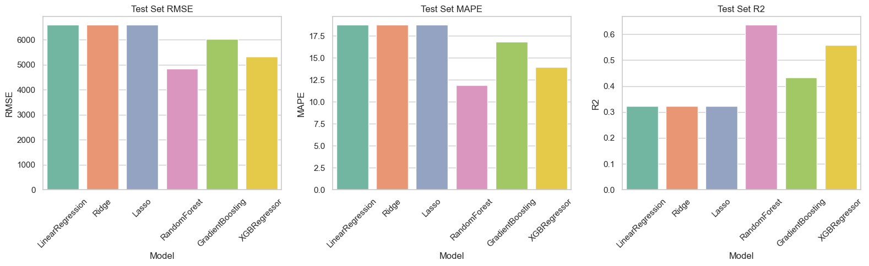
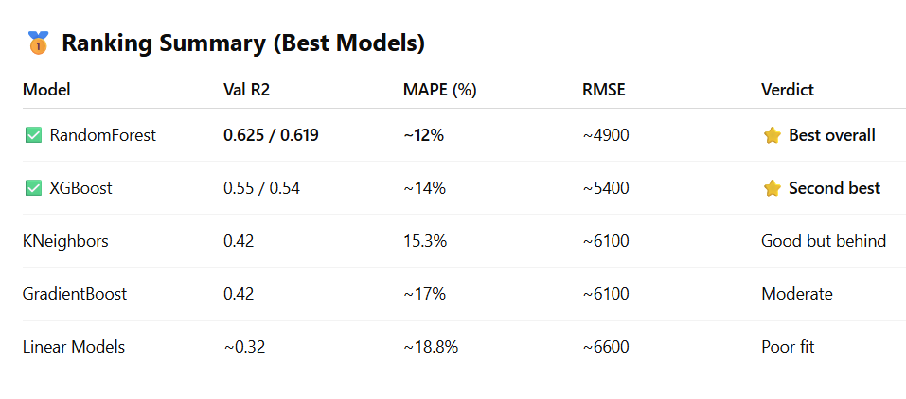
Data Splitting
[ ML ] Model Train + Evaluation
Performance Metrics
80% training, 20% testing split for model evaluation.
Evaluated models using R2, Adj R2 score, MSE, MAPE, and RMSE.
1
2
3
Hyperparameter Tuning
Used GridSearchCV to optimize model parameters.

Slide 7
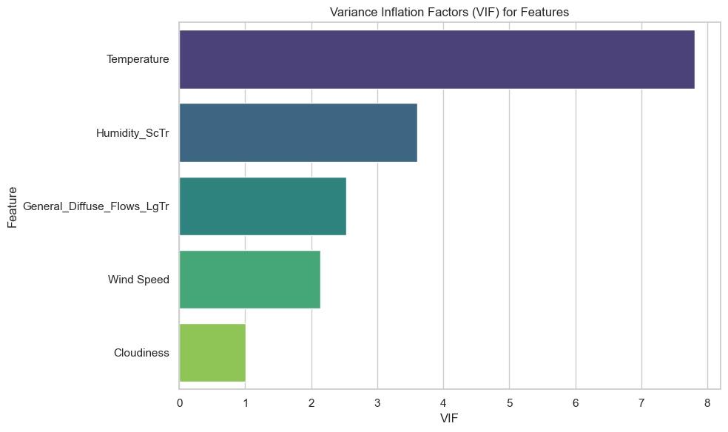
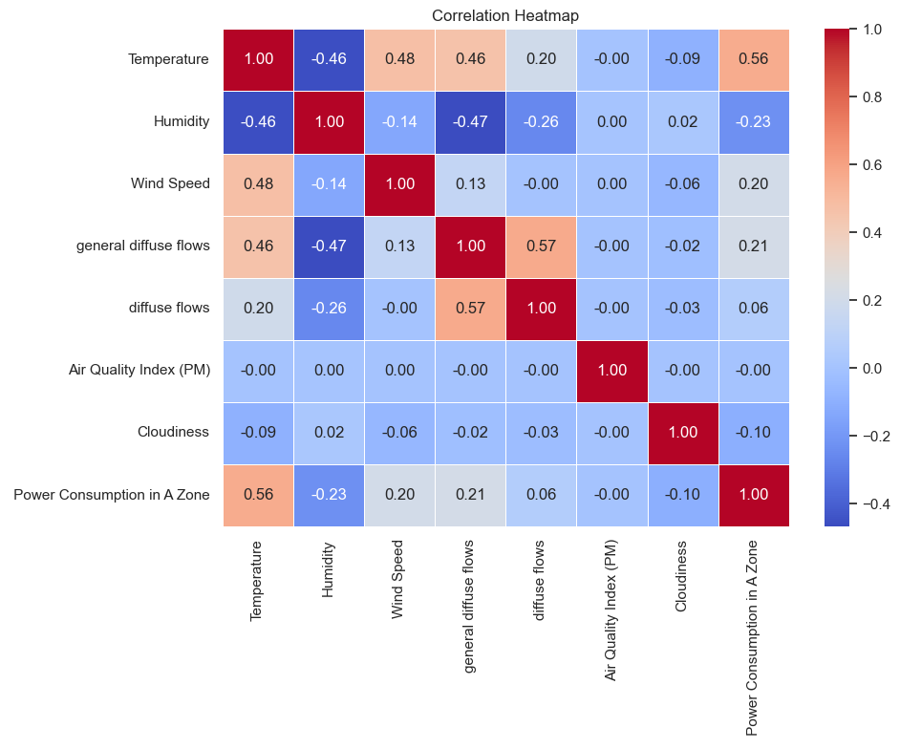
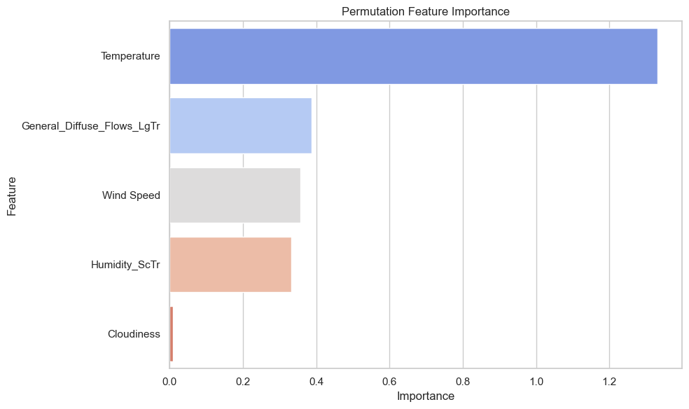
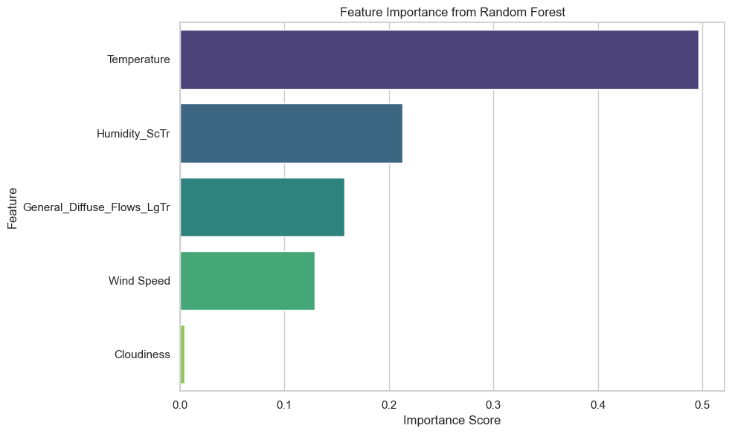
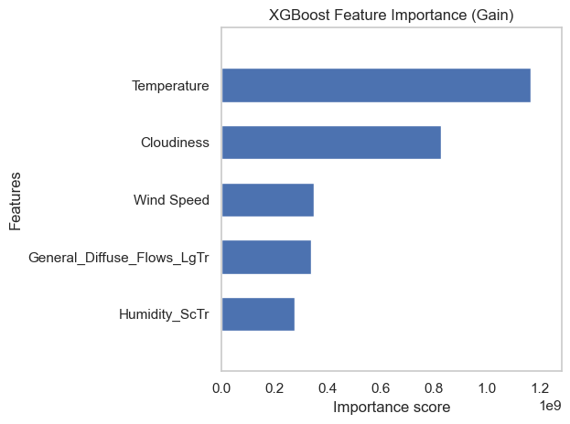
[ ML ] Feature Selection

Slide 8

[ Project ] Way Forward
Include more weather
parameters
Train
Deep Learning models :
– ANN , RNN , LSTM
explore more Feature Engineering and Feature Selection Techniques.
Year
Month
Add Time Series
Components
Week
Day
Train
non–linear models :
– Polynomial Features
Hour
Minute
THANK YOU
Track & Monitor real time data
and Analyse predicted vs actual
Deployment of Best models

